Slide 1
ITCS 3134
KWOK YIN HANG
E07 - Thresholding

Slide 2
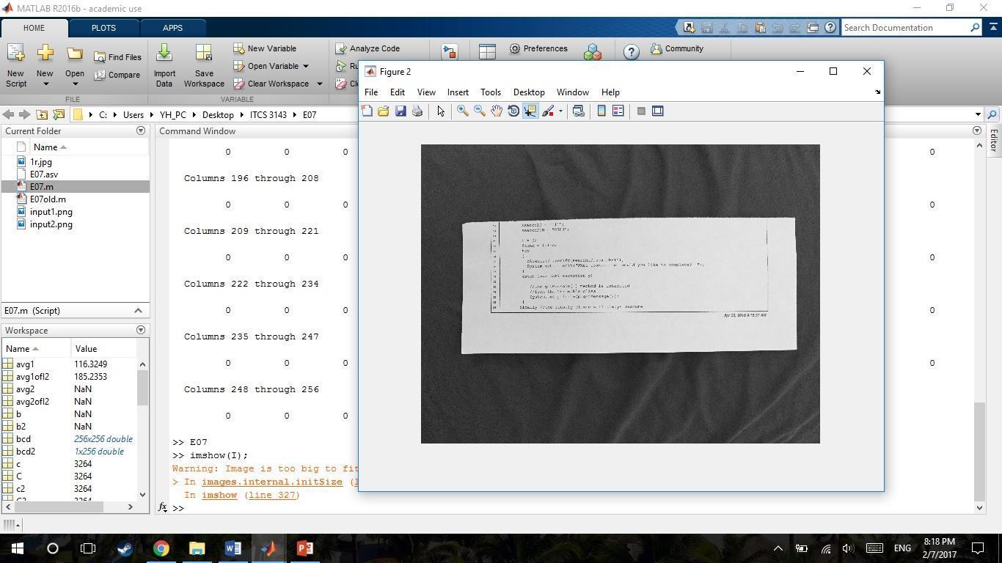
Otsu on input1.png input image
I = imread('input1.png');
imshow(I);

Slide 3
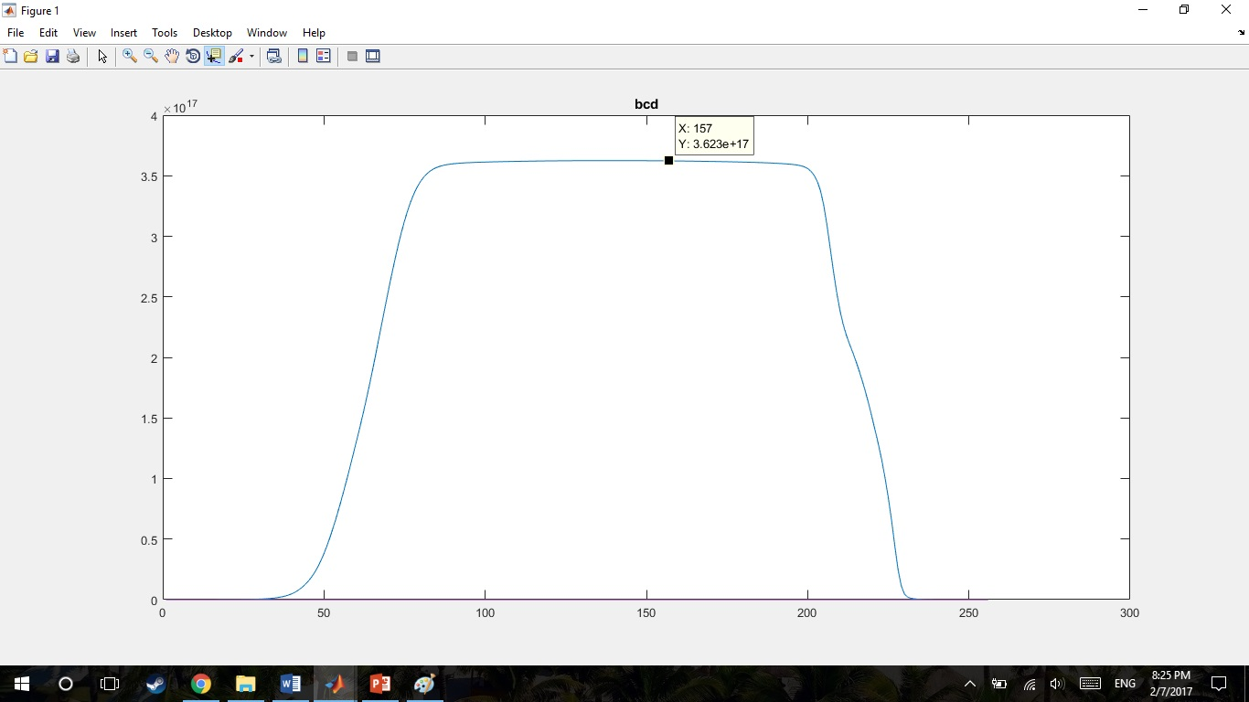
plot of between-class variance
loop
b = omegal * omegal2 *((avg1-avg2)^2);
bcd(t+1)=b;
End
figure;plot(bcd);title('bcd');
m = max(bcd);

Slide 4
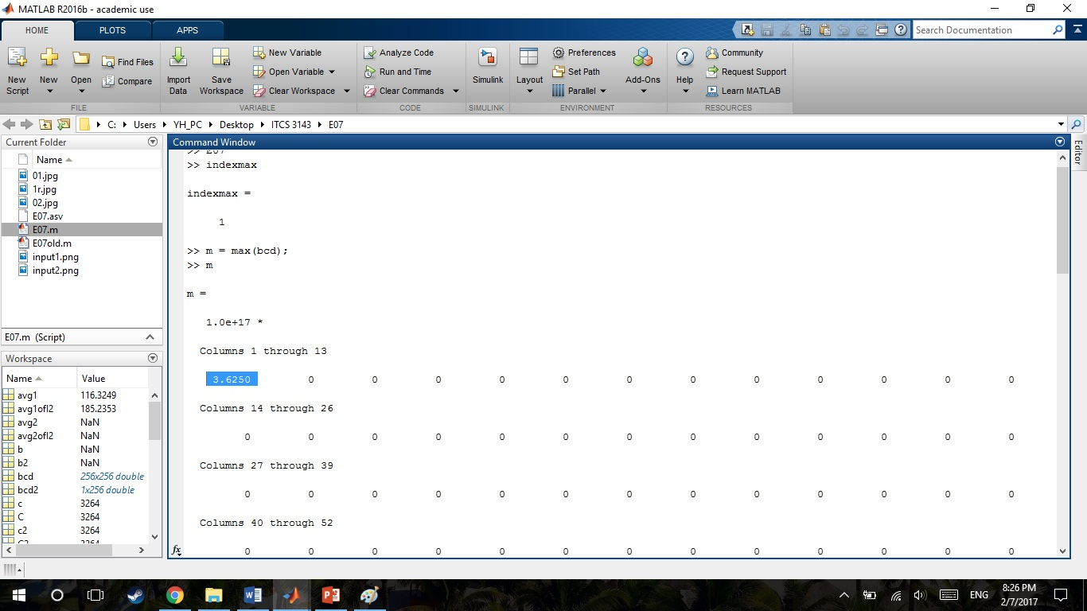
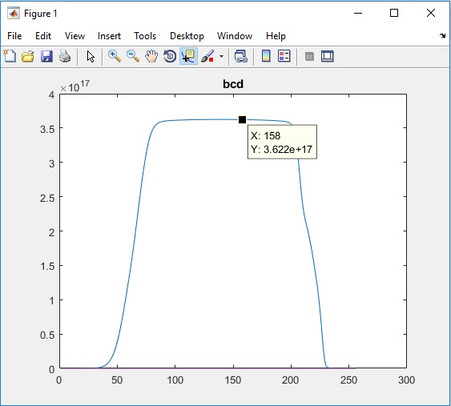
the optimal threshold = T that gives maximum between-class variance
m = max(bcd);

Slide 5
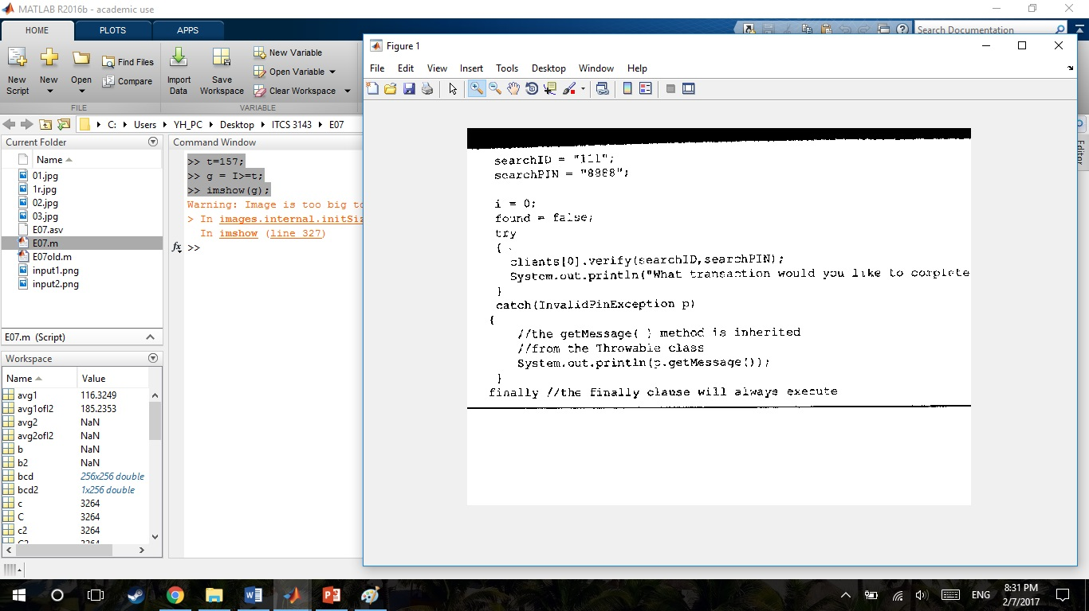
threshold output
>> t=157;
>> g = I>=t;
>> imshow(g);

Slide 6
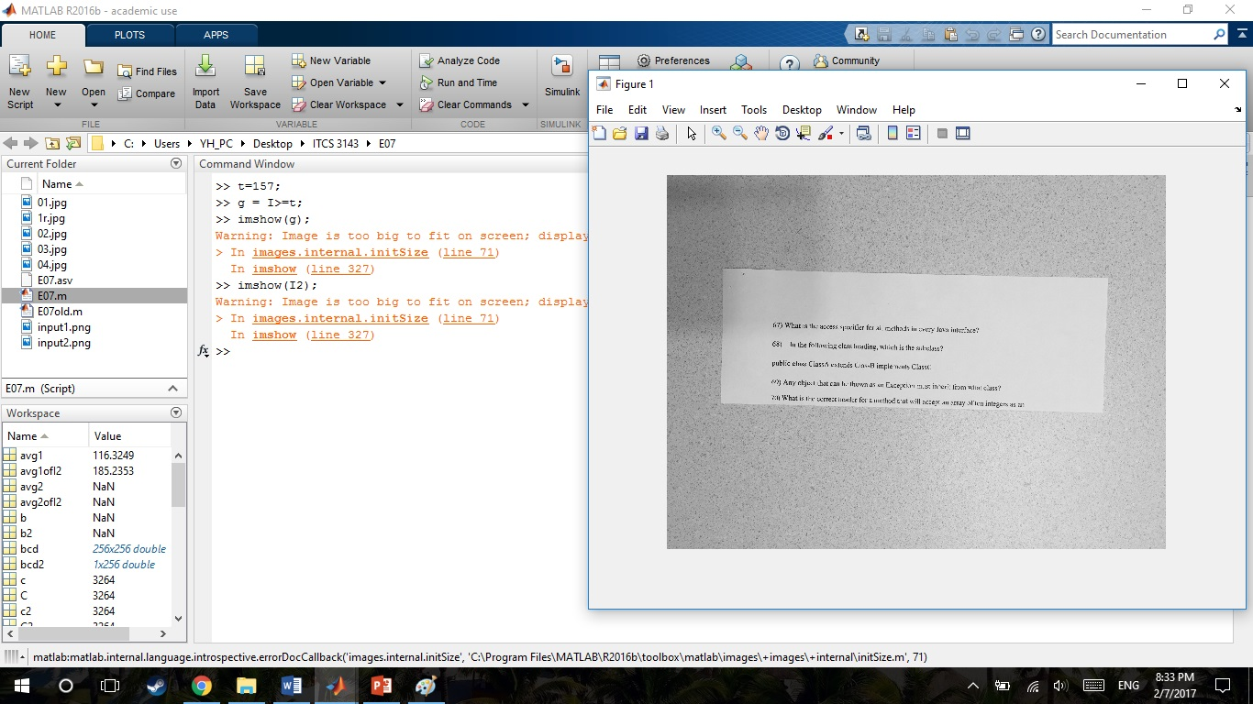
Local thresholding on image2.png input image
I2 = imread('input2.png');
imshow(I2);

Slide 7
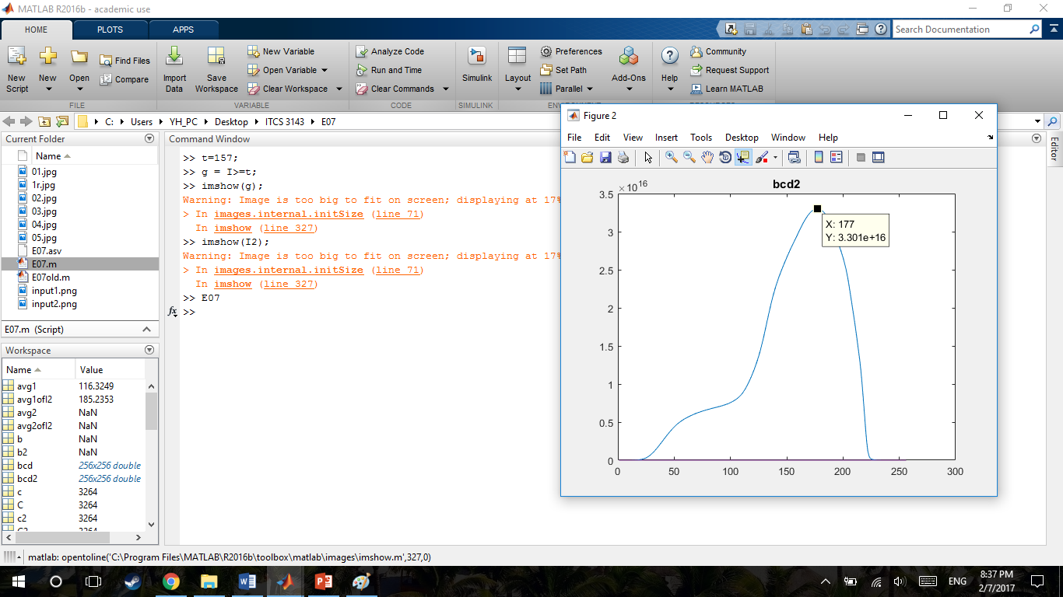
output from Otsu

Slide 8
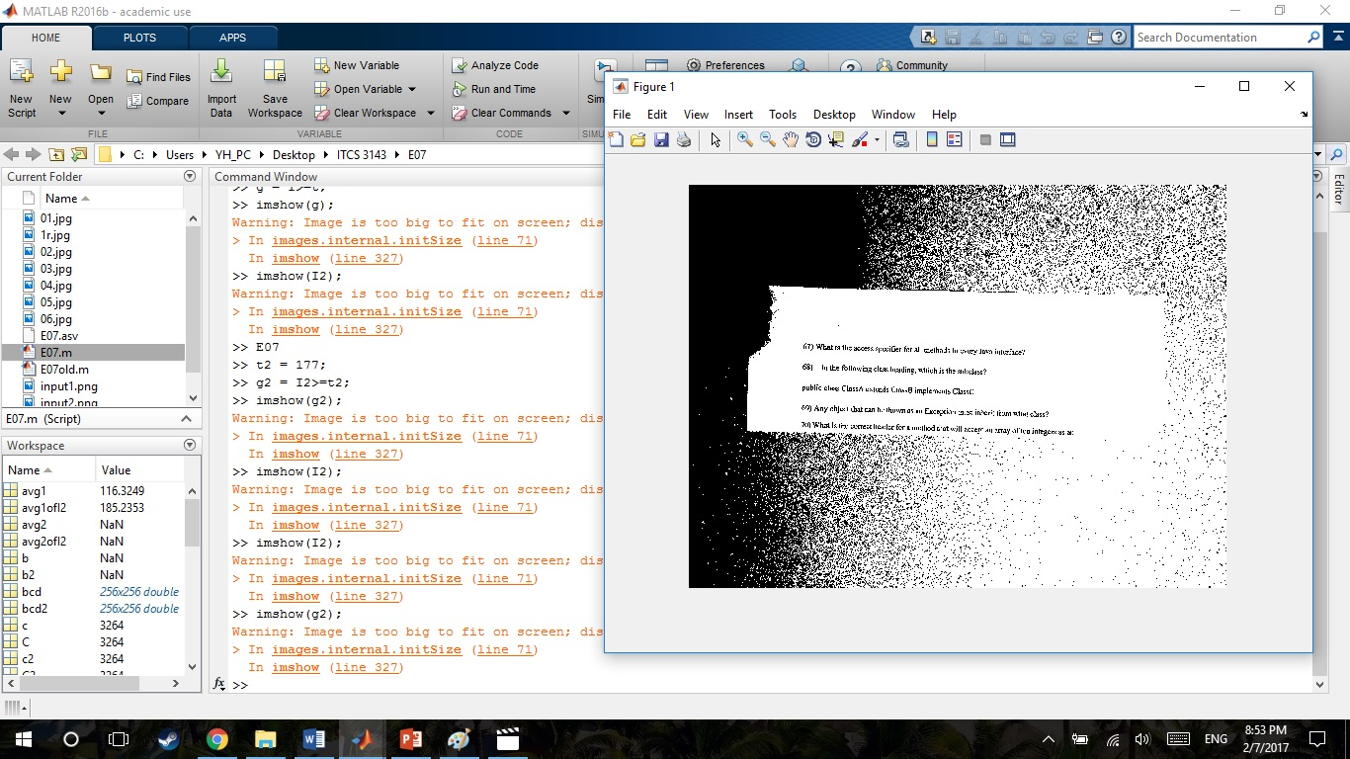
mean image

